Slide 1
Chapter No.2 Processor, Motherboard, System Clock, Expansion Slot and Power supply

Slide 2
Processor
A processor, or "microprocessor," is a small chip that resides in computers and other electronic devices. Its basic job is to receive input and provide the appropriate output. While this may seem like a simple task, modern processors can handle trillions of calculations per second.

Slide 3
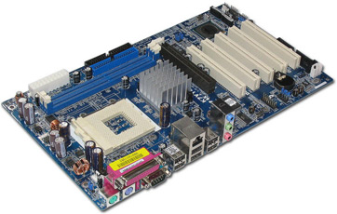
Motherboard
A motherboard is one of the most essential parts of a computer system. It holds together many of the crucial components of a computer, including the central processing unit (CPU), memory and connectors for input and output devices.
Motherboard contains a number of sockets and slots to connect the other components.

Slide 4
System clock
A system clock or system timer is a continuous pulse that helps the computer clock keep the correct time. It keeps count of the number of seconds, and uses that data to calculate the current date and time.

Slide 5
Expansion slot
An expansion slot is a connection or port inside a computer on the motherboard.
It provides an installation point for a hardware expansion card to be connected.
For example, if you wanted to install a new video card in the computer, you'd purchase a video expansion card and install that card into the compatible expansion slot.

Slide 6
Power supply
A power supply or PSU (power supply unit) is a hardware component of a computer that supplies all other components with power. The power supply converts AC (alternating current) into a steady low-voltage DC (direct current) usable by the computer and rated by the number of watts it generates.
Modern personal computers universally use switched-mode power supplies. Some power supplies have a manual switch for selecting input voltage, while others automatically adapt to the mains voltage.

Slide 7
